Slide 1
Computer Networks

Slide 2
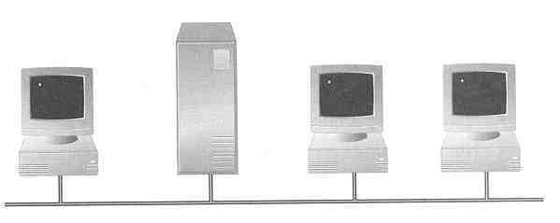
What is a Network
A network consists of two or more devices connected together, and they can communicate and share resources (e.g. information)

Slide 3
Computer Network:
A network consists of two or more computers that are linked in order to share resources, exchange files, or allow electronic communications.
The computers on a network may be linked through cables, telephone lines, radio waves, satellites, or infrared light beams

Slide 4
Need of Computer Network:
File sharing
Resource sharing
Communication and collaboration
Remote access
Data protection

Slide 5

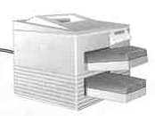
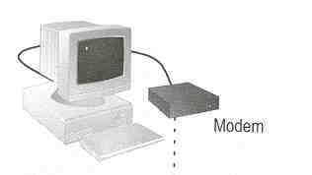
Sharing hardware or software
E.g. print document
Centralize administration and support
E.g. Internet-based, so everyone can access the same administrative or support application from their PCs

Slide 6
Advantages of a network :
Resources (Hardware and Software) can be shared; File sharing
Allows more effective communication between users e.g. via e-mail.
Networks are cheaper than “stand-alone PCs.” / Inexpensive Set-Up
Information held on the network can be accessed by all users with authorised access.
Flexible Handling
Increased Storage Capacity

Slide 7
Disadvantages of a network
The set-up and maintenance costs can be expensive.
A fault with the network server can cause difficulties with the organisation / Lack of Robustness
Needs An Efficient Handler
Networks need security measures to restrict access to users.
WANs are vulnerable to hackers and viruses.

Slide 8
How many kinds of Networks?
Based on network size: LAN and WAN (and MAN)
Based on topology (connectivity): logical eg Ethernet, Token Ring; physical eg star, ring, bus, mesh, tree, ring
Based on transmission media: Wired (UTP, coaxial cables, fiber-optic cables) and Wireless
Based on structure / management method: Peer-to-peer and Client/Server, cloud, cluster, centralised, virtualised

Slide 9
Performance Parameters
Bandwidth: The amount of data which can be transmitted on a medium over a fixed amount of time (second). It is measured on Bits per Second
Bits per Second (bps): A measure of transmission speed. The number of bits (0 0r 1) which can be transmitted in a second
Throughput is a measure of how many units of information a system can process in a given amount of time.
Throughput is then calculated by dividing the file size by the time to get the throughput in megabits , kilobits, or bits per second.
Data transfer rate The speed with which data is moved from one place on a network to another

Slide 10
NETWORKS: categorized by size
LAN – a network that connects computers in a limited
geographical area.
MAN – a backbone that connects LANs in a metropolitan
area such as a city and handles the bulk of communications
activity across that region.
WAN – covers a large geographical area such as a city or
country. Communication channels include telephone lines,
Microwave, satellites, etc.
Notes:
LAN local area network

Slide 11
Local Area Network (LAN)
Small network, short distance
A room, a floor, a building
Limited by no. of computers and distance covered
Usually one kind of technology throughout the LAN
Examples:
Network inside the Computer labs
Network inside your home
Serve a department within an organization

Slide 12
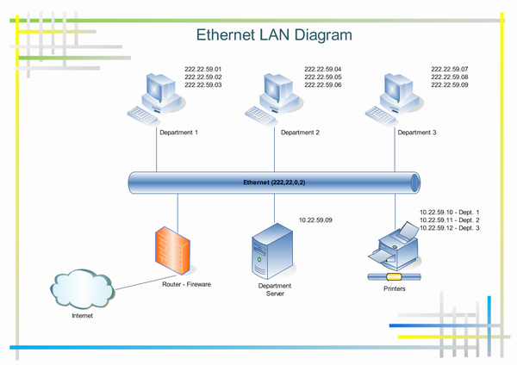

Slide 13
Wide Area Network (WAN)
A network that uses long-range telecommunication links to connect 2 or more LANs/computers housed in different places far apart like Towns, states, countries
Examples:
Network of Bolton Campus
Internet
Your home
WAN
UK
Student Computer Centre

Slide 14
Metropolitan Area Network (MAN):
A metropolitan area network (MAN) is a network that interconnects users with computer resources in a geographic area or region larger than that covered by even a large local area network but smaller than the area covered by a wide area network (WAN).
It is also used to mean the interconnection of several local area networks by bridging them with backbone lines

Slide 15
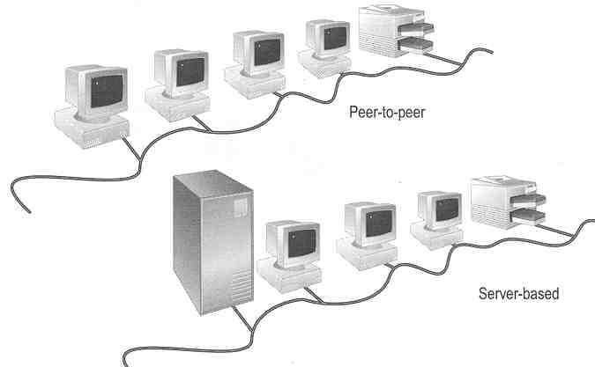
Management method

Slide 16
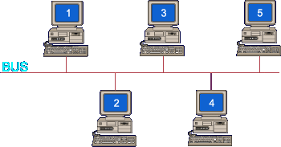
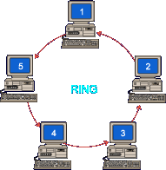
NETWORK TOPOLOGIES Physical(categorizing by shape)
Notes:
Contention occurs on star and bus networks.

Slide 17
Star Topology
A local-area network (LAN) that uses a star topology in which all nodes are connected to a central computer.
Advantages
one malfunctioning node
doesn't affect the rest of
the network.
easy to add and remove nodes.
Disadvantages
if the central computer fails, the entire network becomes unusable
require more cabling

Slide 18
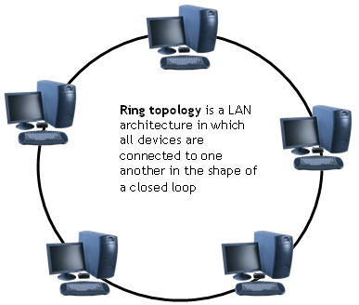
Ring Topology
Uses an empty data packet called a token and a special protocol called “token ring”. Packets travel around the ring in a clockwise direction. Clients require an empty token to transmit data.
Advantages
- no collisions because all data travels in same direction.
Disadvantages
- fails if an individual node in the network fails

Slide 19
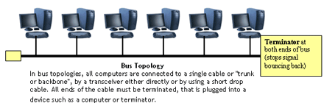
BUS TOPOLOGY
A bus is a form of Ethernet. Nodes linked by a cable known as the bus. Bus transmits in both directions and uses CSMA/CD protocol
Advantages - Easy to set up and maintain failure of one node does not affect network | Disadvantages Higher rate of data collision than with a bus network fails if there is any damage to the bus
Notes:
Easy to add extra computers . If computer goes down it doesn’t affect rest of network

Slide 20
Transmission Media
twisted pair – telephone cable
coaxial cable –Thick black cable used for higher bandwidth communications than twisted pair
fibre optic – data transferred through pulses of light. Extremely fast.
Non cable methods such as satellite, microwave, wireless and Bluetooth

Slide 21
Network Hardware
SERVERS: Help to manage the network and the resources of that network. On larger networks servers commonly have specialised tasks such as: File Servers: stores and manages files, Print Servers: manages printers and print jobs, Mail Server: Manages email, Web Server: manages web access.
Routers: connects multiple networks and are protocol independent. can be used in place of a switch or bridge.
Switches: smart hubs which transmit packets to the destination port only
Hubs: like double adapters /power boards in the home except instead of plugging in extension cords we are plugging in computers to allow them to communicate.

Slide 22
Bridge
Large networks can be separated into two or more smaller networks using a bridge. This is done to increase speed and efficiency. This type of network is called a segmented LAN and has largely been superseded by the use of switches which can transfer data straight to a computer and thus avoid bottleneck jams which bridges were designed to fix.
Bridge
Notes:
Devives that connect local area networks
If a BUS or ring then a Gateway needs to be used

Slide 23
Router
Often used to connect a LAN with a WAN. Gateways join two or
More different networks together.
Gateway

Slide 24
Protocols
A protocol is a set of rules which governs the transfer of data between computers. Protocols allow communication between computers and networks.
Handshaking is used to establish which protocols to use. Handshaking controls the flow of data between computers
protocols will determine the speed of transmission, error checking method, size of bytes, and whether synchronous or asynchronous

Slide 25
Examples of protocols
Layer 7 application
Layer 6 presentation
Layer 5 session
Layer 4 transport
Layer 3 network
Layer 2 data link
Layer 1 physical
E-mail, Web browser, Directory
POP, SMTP, FTP, HTTP, DNS
Sockets
TCP
IP
PPP, Ethernet, Token ring
100baseT

Slide 26
Thank You

